Slide 1
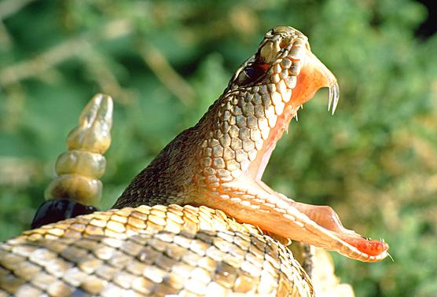
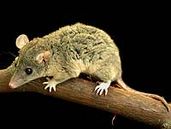
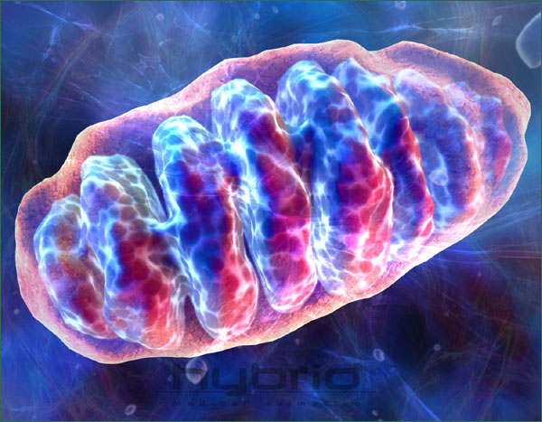
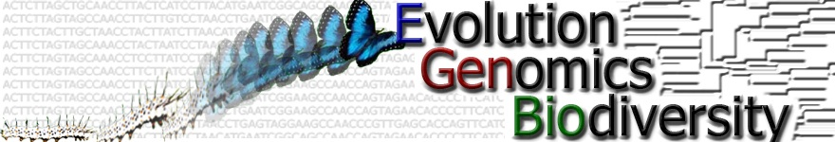
Evolution of Proteins: Proteins 7350
Pollock_ProteinEvol5.ppt

Slide 2
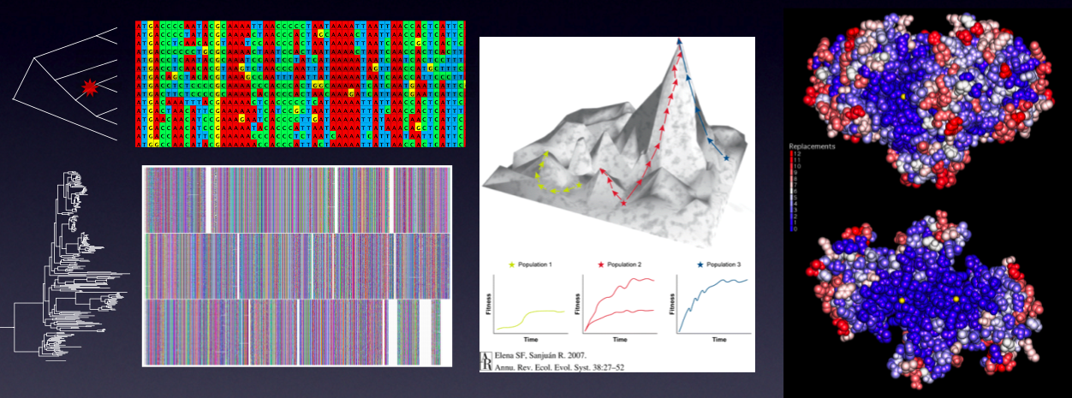
Evolution of Proteins
Jason de Koning

Slide 3
Description
Focus on protein structure, sequence, and functional evolution
Subjects covered will include structural comparison and prediction, biochemical adaptation, evolution of protein complexes…

Slide 4
Topics (continued)
…Probabilistic methods for detecting patterns of sequence evolution, effects of population structure on protein evolution, lattice and other computational models of protein evolution, protein folding and energetics, mutagenesis experiments, directed evolution, coevolutionary interactions within and between proteins, and detection of adaptation, diversifying selection and functional divergence.

Slide 5
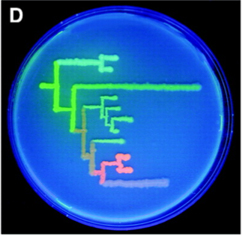
Reconstruction of Ancestral Function

Slide 6
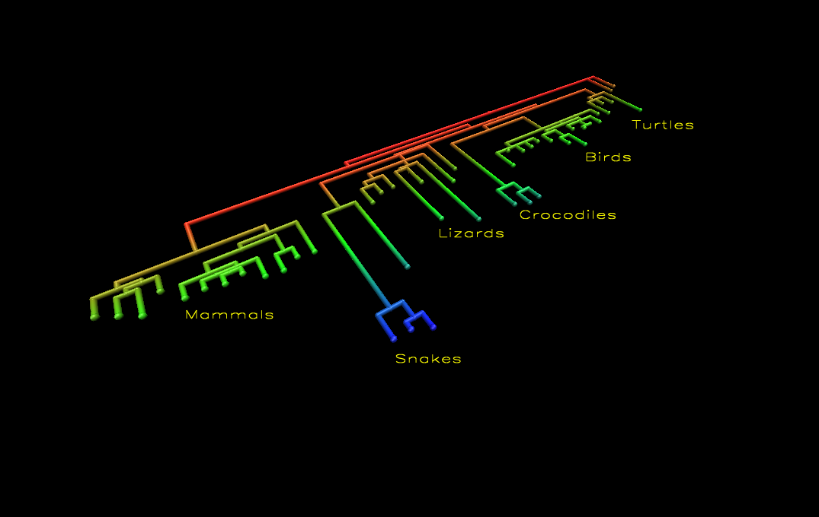
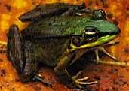


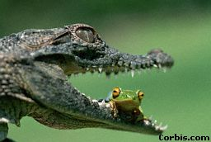
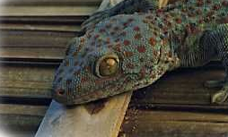


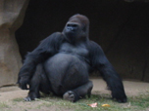
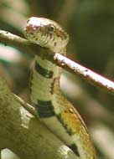

Slide 7
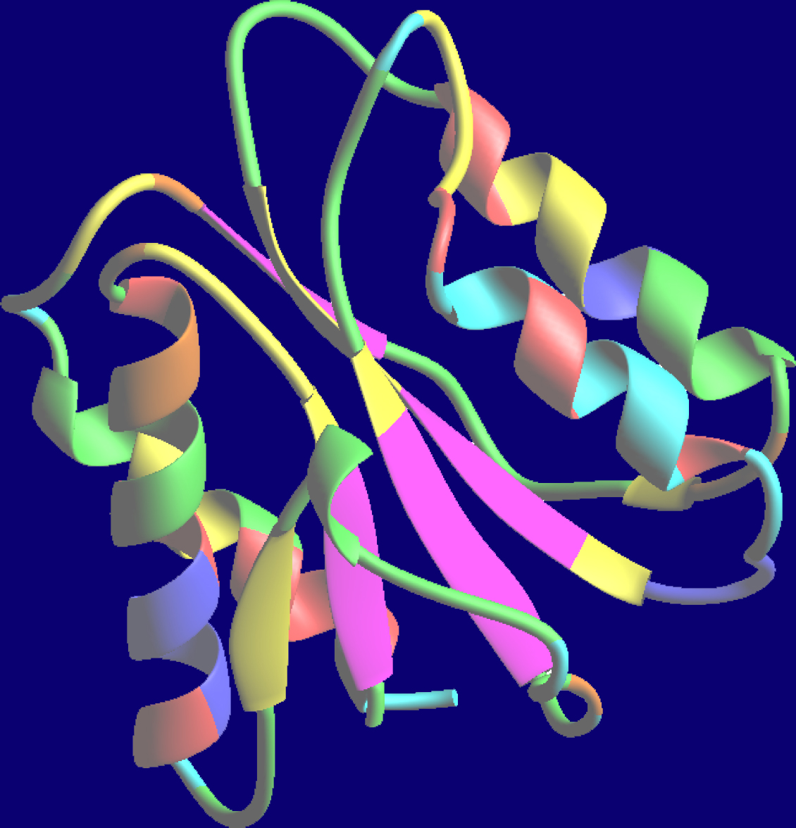
How do You Understand a New Protein?

Slide 8
Structural and Functional Studies
Experimental (NMR, X-tallography…)
Computational (structure prediction…)

Slide 9
Comparative Sequence Analysis
Looking at sets of sequences
A common but wrong assumption: sequences are a random sample from the set of all possible sequences
Mouse: …TLSPGLKIVSNPL…
Rat: …TLTPGLKLVSDTL…
Baboon: …TVSPGLRIVSDGV…
Chimp: …TISPGLVIVSENL...
Mouse: …TLSPGLKIVSNPL…
Rat: …TLTPGLKLVSDTL…
Baboon: …TVSPGLRIVSDGV…
Chimp: …TISPGLVIVSENL...
Mouse: …TLSPGLKIVSNPL…
Rat: …TLTPGLKLVSDTL…
Baboon: …TVSPGLRIVSDGV…
Chimp: …TISPGLVIVSENL...
Conserved
proline
Conserved
proline
Variable
“High entropy”

Slide 10
Comparative Sequence Analysis
Looking at sets of sequences
In reality, proteins are related
by evolutionary process

Slide 11
Confounding Effect of Evolution
…TLSKRNPL…
S→F
P→T
…TLFKRNPL…
…TLSKRNTL…
…TLSKRNT…
…TLFKRNP…
…TLFKRNP…
…TLSKRNT…
…TLSKRNT…
…TLFKRNP…

Slide 12
Confounding Effect of Evolution
…TLSKRNPL…
S→F
P→T
…TLFKRNPL…
…TLSKRNTL…
…TLSKRNT…
…TLFKRNP…
…TLFKRNP…
…TLSKRNT…
…TLSKRNT…
…TLFKRNP…
Everytime there is an F, there is a P!
Everytime there is an S, there is a T!

Slide 13
Ways to Deal with This…
Most common: Ignorance is Bliss
Some: Try to estimate the extent of the confounding (Mirny, Atchley)
Remove the confounding (Maxygen)
Include evolution explicitly in the model (Goldstein, Pollock, Goldman, Thorne, …)

Slide 14
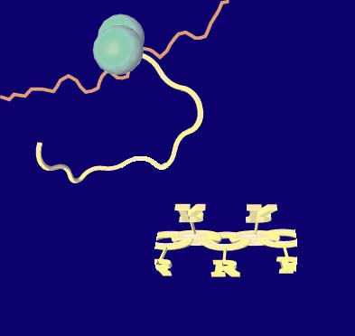
Stochastic Realizations
Fitness
Selection
Selective
Pressure
Folding
Mouse: …TLSPGLKIVSNPL…
Rat: …TLTPGLKLVSDTL…
Baboon: …TVSPGLRIVSDGV…
Chimp: …TISPGLVIVSENL...
Stability
A
B
Function
C

Slide 15
Understanding
Model
Data
Selective
Pressure
Folding
Mouse: …TLSPGLKIVSNPL…
Rat: …TLTPGLKLVSDTL…
Baboon: …TVSPGLRIVSDGV…
Chimp: …TISPGLVIVSENL...
Stability
A
B
Function
C

Slide 16
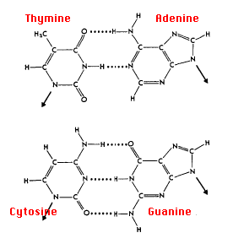
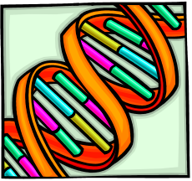
Purines
Pyrimidines
DNA

Slide 17
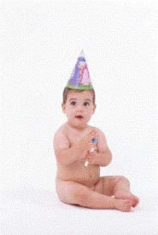
What does DNA do?
Replication
Translation
Folding
Function
mRNA
Protein
DNA
Protein

Slide 18
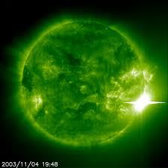
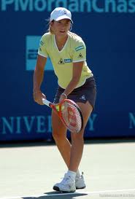

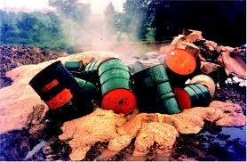


Mutations result in genetic variation

Slide 19






Selective
Pressure

Slide 20
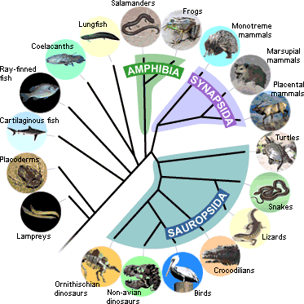


Slide 21
Genetic changes
…UGUACAAAG…
Substitution
Insertion
Deletion
…UGUAUAAAG…
…UGUAAAAG…
…UGUUACAAAG…

Slide 22
Substitutions Can Be:
Transitions
Purines: A G
Pyrimidines: C T
Transversions

Slide 23
Substitutions in coding regions can be:
Cys Arg Lys
UGU/AGA/AAG
Silent
Nonsense
Missense
UGU/CGA/AAG
UGU/GGA/AAG
UGU/UGA/AAG
Cys Arg Lys
Cys Gly Lys
Cys STOP Lys
First position: 4% of all changes silent
Second position: no changes silent
Third position: 70% of all changes silent (wobble position)

Slide 24
Homologous crossover
Uneven crossover leading to gene deletion and duplication
Gene conversion

Slide 25
Fate of a duplicated gene
Keep on doing whatever it originally was doing
Lose ability to do anything
(become a pseudogene)
Learn to do something new (neofunctionalization)
Split old functions among new genes (subfunctionalization)

Slide 26
Homologies
Gene
duplication
α Hemoglobin
β Hemoglobin
Speciation
Mouse
α Hb
Rat
α Hb
Mouse
β Hb
Rat
β Hb
Paralogs
Orthologs

Slide 27
Initial Population

Slide 28
Mistakes are Made

Slide 29
Elimination

Slide 30
Polymorphism

Slide 31
Fixation

Slide 32
Selection
Differences in fitness (capacity for fertile offspring)
1 gene
2 alleles (variations), A and B
3 genotypes (diploid organism): AA, AB, BB
Genotype Fitness
AA ω_{AA} = 1 (wild type)
AB ω_{AB} = 1 + S_{AB}
BB ω_{BB} = 1 + S_{BB}
S > 0 advantageous
S < 0 unfavorable
S ~ 0 neutral

Slide 33
Evolution of Gene Frequencies
q = frequency of B
p = (1-q) = frequency of A
, ,
∞ population: differential equation for p, q
q(next generation)
pq[ps_{AB} + q(s_{BB}-s_{AB})]
= q(this generation) +
p² + 2pq(s_{AB}+1) + q²(s_{BB}+1)

Slide 34
Fixation of an Advantageous
Recessive Allele (s=0.01)
Genotype Fitness Value
Frequency of B
AA 1.0
AB 1.0 (recessive)
BB 1.01
Generation

Slide 35
Equilibration of an Overdominant Allele
Frequency of B
Genotype Fitness Value
AA 1.0
AB 1.02
BB 1.01
Generation
Notes:
Steady-state:
Overdominant selection
Frequency-dependent selection
New mutations competing with elimination/fixation
(dynamic steady state)
Transient

Slide 36
Probability of fixation =
1-e^{-2s}
1-e^{-2Ns}
1
N = 10
10⁻⁰²
N = 100
10⁻⁰⁴
= 2s (large, positive S,
large N)
N = 1000
10⁻⁰⁶
Fixation probability
= 1/(2N) when |s| < 1/(2N)
10⁻⁰⁸
10⁻¹⁰
N = 10,000
10⁻¹²
10⁻¹⁴
-0.01
0
0.01
0.02
Selective advantage (s)

Slide 37
Real phylogenetic trees

Slide 38
Different Rates of Substitutions
DNA substitution rate depends on
location in the genome
coding or non-coding
synonymous or non-synonymous
identity and location on protein
Non-coding regions, coding region synonymous substitutions
~ 3-4 x 10⁻⁹ substitutions/site year
Coding regions, non-synonymous substitutions
Histones ~0
Insulin 0.2 x 10⁻⁹
Myoglobin 0.57 x 10⁻⁹
γ Interferon 2.59 x 10⁻⁹
Relaxin 3.06 x 10⁻⁹

Slide 39
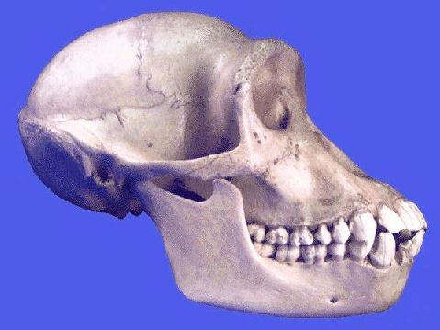
Interpreting Evolutionary Changes Requires a Model
…IGTLS…
…IGRLS...
In evolution:
what is the rate R(T R) at which Ts become Rs?
20 x 20
Substitution Matrix
e.g. 0.00005 / my

Slide 40
Using Current Sequences to Develop the Evolutionary Model
Mouse: …TLSPGLKIVSNPL…
Rat: …TLTPGLKLVSDTL…
Baboon: …TVSPGLRIVSDGV…
Chimp: …TISPGLVIVSENL...
Mouse: …TLSPGLKIVSNPL…
Rat: …TLTPGLKLVSDTL…
Baboon: …TVSPGLRIVSDGV…
Chimp: …TISPGLVIVSENL...
I
?
Raboon
Raboon
L
?
I
Rouse
?
Rouse
Chaboon
Chaboon
Each location
I
I
L
L
I
I
I
I
Mouse
Mouse
Rat
Rat
Baboon
Baboon
Chimp
Chimp
One I L transition
One L I transition
We need to find the
best model for the data

Slide 41
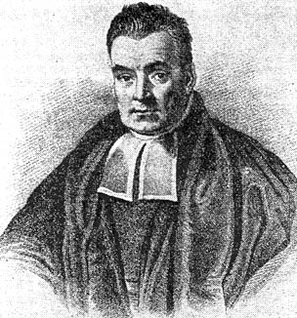
Find the Best Model Using Statistical Methods
In the absence of other information, the best model is the one that maximizes the probability that the data would result IF the model were correct
Rev. Thomas Bayes
(1702-1761)

Slide 42
Maximizing the Probability that the Data would Result if the Model were Correct
Maximize Log Likelihood or Posterior Probability
Log{P(Observed data|Evolutionary Model)}
=Σ { ( | )}
?
log P
?
?
_{locations}
I
L
I
I

Slide 43
Finding the Best Model
Sequence data
altsprvglsnrkh
altsprvglsnrkh
altsprvglsnrkh
altsprvglsnrkh
altsprvglsnrkh
altsprvglsnrkh
Log-likelihood
20 x 19 = 380 substitution rates

Slide 44
Reconstruction of Ancestral Proteins
A
Raboon
What is the probability that the Raboon had an A at this position?
Rouse
Y
Z
Chaboon
I
L
I
I
Mouse
Rat
Baboon
Chimp

Slide 45
Reconstruction of Ancestral Proteins
A
Raboon
P(Raboon had an A | model) =
Σ
Rouse
Y
Z
P(Data | Model)
Chaboon
All possible paths starting with A
Σ
I
L
I
I
P(Data | Model)
Mouse
Rat
Baboon
Chimp
All possible paths

Slide 46
Probabilistic Reconstruction
V
Y
W
T
S
P
F
M
K
L
I
H
G
E
Q
C
D
N
R
A
-
85
100
120
140
160
Residue Number

Slide 47
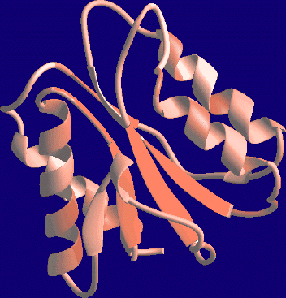
Assumption: R(T S) is the Same For All Locations
T
T
T
Same for: inside, outside, helix, sheet, coil, active site, dimerization site ...

Slide 48

We Would Like Separate Substitution Matrices for Each Location
T
T
T
380N adjustable parameters!
N is the number of residue positions

Slide 49
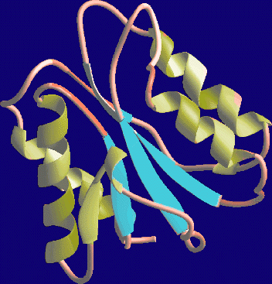
Proteins have Structure
Different Matrices for Different Local Structures
T
T
T

Slide 50
Exposed
Coil
Buried
Helix
-LIVFMWACPGYTSHQNEDKR
-LIVFMWACPGYTSHQNEDKR
-LIVFMWACPGYTSHQNEDKR
-LIVFMWACPGYTSHQNEDKR
Note difference in gap creation

Slide 51
Buried
Helix
Buried
Sheet
Buried
Turn
Buried
Coil
Exposed
Helix
Exposed
Sheet
Exposed
Turn
Exposed
Coil
Notes:
We can go one step further…

Slide 52
Buried
Mesophile
Buried
Thermophile
Exposed
Mesophile
Exposed
Thermophile
Notes:
Differences in where the organisms live

Slide 53
Is This Enough?
Assumes all locations in a given local structure evolve identically
Ignores complex nature of structural constraints
Ignores functional constraints
  active sites
  dimerization sites
Ignores any other type of selective pressure
Designation between local structure categories somewhat arbitrary
What about proteins of unknown structure?

Slide 54
Different “Site Classes”
Each with its own matrix
T
T
T

Slide 55
We Don’t Know Which Locations Belong to Which Site Classes…
?
T
?
T
T
?

Slide 56
…Or the Matrices Corresponding to These Site Classes
?
T
?
?
T
T
?
?

Slide 57
If we knew which locations in the protein belonged to which site classes, our troubles would be over
What is the best model (max Log Likelihood) for the locations in this site class.
If we knew what the set of models were, our troubles would be over
Which model fits each location best
(max Log (Likelihood x P(that model))?

Slide 58
Solution: Iterate
Assign all locations to most appropriate site class
(at first at random)
Find the best model for the locations assigned to each site class

Slide 59
Don’t know:
Substitution models
Which location fits which model
Iterate
Site Class | Presence | Overall rate | R(K →F) | R(F →K) | Common AA
1 | 6% | Conserved | Zero | Zero | His, etc.
2 | 18% | Slow | Moderate | Rare | Aromatics
3 | 26% | Moderate | Moderate | Slow | Hydrophobes
4 | 32% | Fast | Moderate | Rapid | Hydrophiles
5 | 18% | Very Fast | Fast | Speedy | Flexible

Slide 60
Can Identify:
Different types of selective pressure
Which locations under which type of pressure
Locations under distinctive selective pressure
Changes in selective pressure
Selective pressure that depends upon subclass (identity of ligand, location in cell, etc.)

Slide 61
Exposed Locations
Properties of Common Amino Acids
Faster-varying
Slower-varying
small
α-helical
turn
large
β-sheet
hydrophobic
hydrophilic

Slide 62
Buried Locations
Properties of Common Amino Acids
Faster-varying
Slower-varying
hydrophilic
hydrophobic
α-helical
turn
large
Small
β-sheet

Slide 63
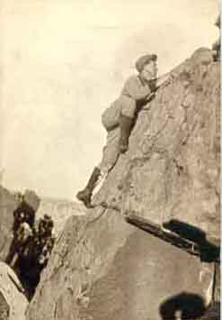
Two Extreme Views of Evolution
Adaptionists
(Dawkins, etc.)
Neutralists
(Kimura, Gould)
Every day, in every way,
I'm getting better and better!
- Emile Coue
“Nearly-neutral model”

Slide 64
When We Observe Something…
Adaptionists:
If it exists, in must be an adaptation.
Why is it necessary/helpful/useful for survival?
What is its purpose?
Neutralists:
Random fixation of chance event
Stochastic processes
Can reflect number of possibilities (sequence entropy)

Slide 65
Of Course Adaptation Occurs
High selective pressure
Large populations
Of Course Neutral Drift Occurs
Low selective pressure
Small populations (bottlenecks)

Slide 66
~10²⁰ Mutations, 10,000 Accepted:
Chance or Necessity?
Adaptionists:
10²⁰ unfavorable mutations accepted with probability 0
10,000 positive mutations accepted with probability 1
Neutralists:
10²⁰ unfavorable mutations accepted with probability 0
10¹⁰ neutral mutations accepted with probability 10⁻⁶
100 positive mutations accepted with probability 1
Result: 99% of observed mutations are neutral
These numbers, like 64% of all statistics, are made up.

Slide 67
Why is it Difficult to Tell?
Changes are “neutral” if |s| < 1/2N_{e}
  well below what we can measure in the lab
  not contradicted by DNA, protein plasticity
Many observations are consistent with both models…
  Example: regions that matter “less” (non-coding regions, etc) change faster

Slide 68
Sequence Space
Most fit

Slide 69
Sequence Space

Slide 70
Reason for Neutral Theory
Large degree of polymorphism
High rate of substitutions
Existence of molecular clock ….

Slide 71
Neutrality and the Molecular Clock?
Adaptive substitutions (s >1/2N):
Population size N, mutation rate μ
2N μ mutations per year
For adaptive mutations
probability of fixation = 2s
Rate of substitutions = mutation rate * P(fixation)
= 4N μs (proportional to N)
Neutral substitutions (|s|<1/2N):
Population size N, mutation rate μ
2Nμ mutations per year
For neutral mutations,
probability of fixation = 1/2N
Rate of substitutions = mutation rate * P(fixation)
= μ (independent of N)

Slide 72
Evidence for the Molecular Clock Cytochrome c
500
Shark
400
Carp
Frog
300
Chicken
Alligator
Fossil divergence time (my)
200
100
Quoll
Cow
Baboon
0
0
0.2
0.4
0.6
0.8
1
Sequence distance from humans

Slide 73
The Molecular Clock is Not Constant
Adaptionists: Ahha!
Neutralists: Other effects:
If mutations due to germ-line replication, rate
should depend upon generation time
Rate of mutations may depend on metabolic rate
(free radicals)
DNA repair efficiency

Slide 74
Panglossian Paradigm:
“It is demonstrable,” said he, “that things cannot be otherwise than as they are; for as all things have been created for some end, they must necessarily be created for the best end. Observe, for instance, the nose is formed for spectacles, therefore we wear spectacles. The legs are visibly designed for stockings, accordingly we wear stockings…”
Voltaire’s Candide

